Slide 1
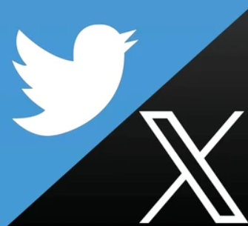
Twitter A/B test
By Yudhishtar Charan

Slide 2
Context and objective
Problem: Twitter's current click-based ad model leads to overspending due to delays in click reporting — advertisers can be billed beyond their set budgets.
Example: If a campaign has $10 left but receives $20 worth of clicks, the extra $10 is overspent (wasted).
Solution Tested: Twitter introduced a new impression-based ad. model (pay-per-impression) to reduce latency and overspending.
Experiment: An A/B test was run, with advertisers randomly assigned to the old click-based or new impression-based model, and results were measured after one week. The product manager has asked us to deliver answers to some questions using statistical methods.

Slide 3
Dataset break-down
Column | Type | Description
treatment | bool | Indicates if the campaign used the new product (True) or the old product (False).
company_size | categorical | Size of the company: Small – Local business Medium – Smaller national brand (e.g., Dell Computers) Large – Global brand (e.g., McDonald's). Impacts how Twitter ads are used.
campaign_spend | decimal | Total amount spent on the campaign during the experiment.
campaign_budget | decimal | Budget allocated for the campaign during the experiment.
Use this link for dataset.

Slide 4
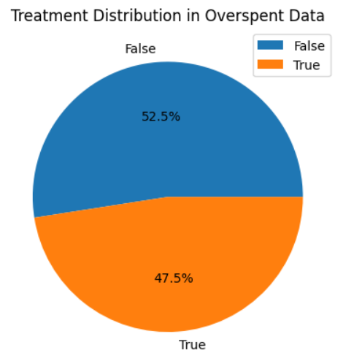
Overspending Breakdown
Breakdown of distribution of data on basis of treatment where overspending is more than 1%

Slide 5
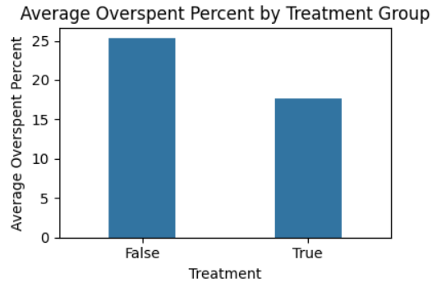
Average overspent percentage
Overspending is less in the Treatment group(17.6%) compared to the control group(25.3%) overall.

Slide 6
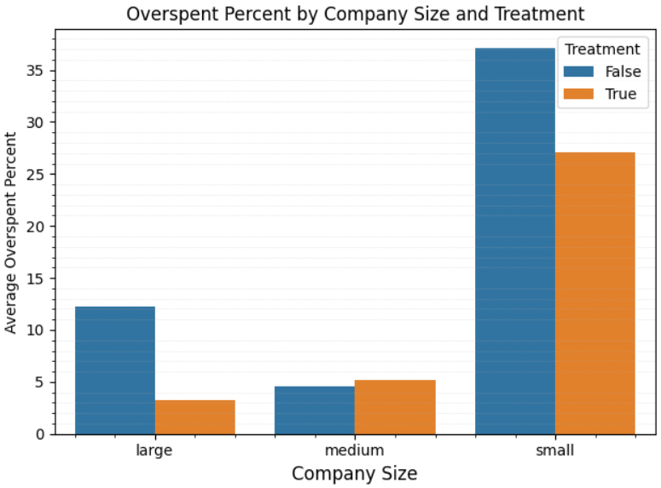
Average overspent percentage at company size level
The difference is statistically significant in control and treatment groups in large and small companies but not in medium sized companies.

Slide 7
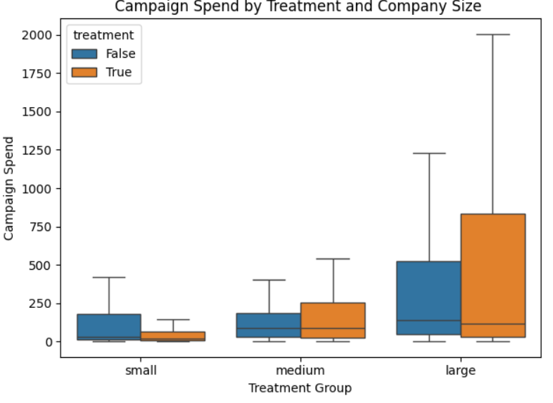
Campaign Spendings
Significant drop of budget in treatment ($1585.48) vs control ($3538.66) on avg for small companies.
The variance is also significantly different for small and large companies.

Slide 8
Result report:
Problem | Result of analysis | Insights
What is number of campaigns in treatment and control group that have spent more than 1% | Treatment False-5716 Treatment True-5180
Is the new product effective at reducing overspend.the average overspend percentage for campaigns in both the control and treatment groups | The median overspending is less in the Treatment group compared to the control group. | Product is effective overall. Overspending: Treatment group (17.6%), control group (25.3%)
Was it more or less effective depending on the company size | The median overspending is less in the treatment group of small and large companies size but not in medium size companies | Product is working well or small and large companies but not (statistically) in medium sized companies
Are certain advertisers in the treatment group entering lower budgets | There is a statistically significant drop in budget in the treatment group but only in small companies. | Significant drop of budget in treatment ($1585.48) vs control ($3538.66) on avg for small companies.
Is the variance different in treatment and control group. | There is a variance difference in small and large company size but not for medium size in the 2 groups. No significant difference in variance overall. | Size: small, Significant difference. Size: medium, No significant difference. Size: large, Significant difference.
Use this link for detailed report and this link for python file.

Slide 9
Thank you!

